Slide 1
Projet g
jeremyhimbeault

Slide 2
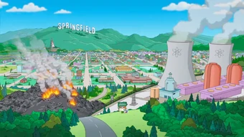
So come an take your time

Slide 3
can I take you home where we can be alone

Slide 4
asked for his name

Slide 7
.
.

Slide 8
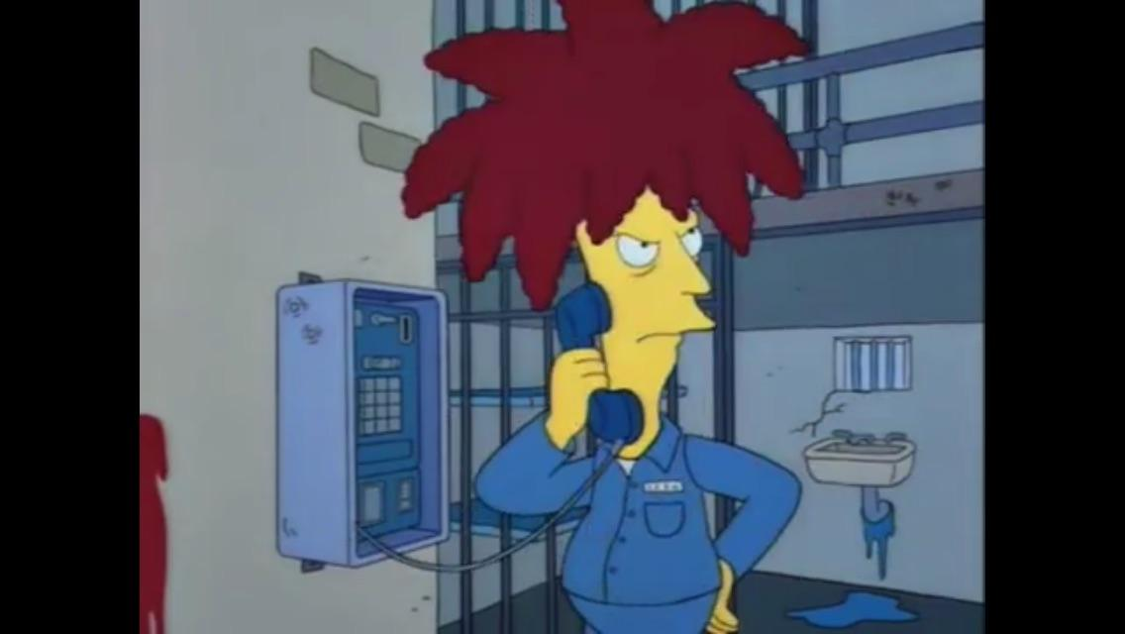

Slide 9
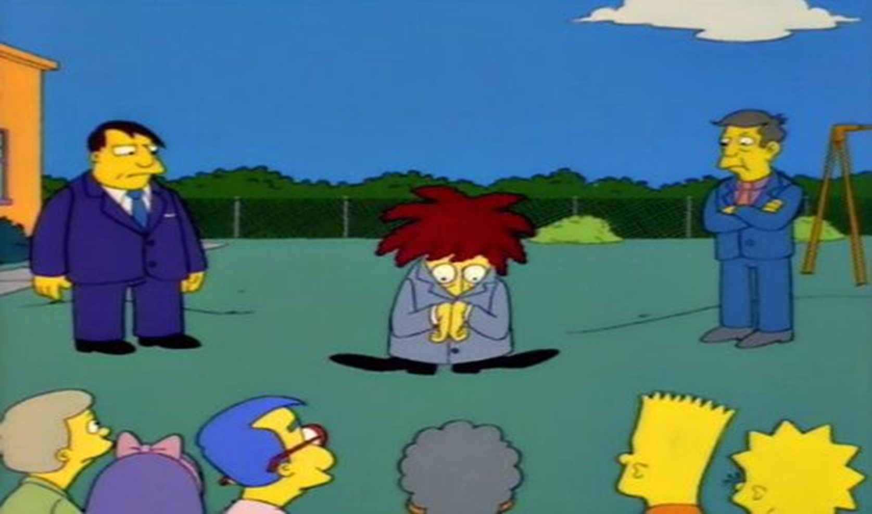

Slide 11
